Slide 1

Project Nexus
Team Nexus:
Alexander Hall, Benjamin Dluzak, David Kopp, Raffi Nalbandian, Vahan Tokadjian

Slide 2
About Project Nexus
Single Page Web Application
Profile Page (Facebook like)
IM System (Ajax IM)
Discussion Forums
Friend Finder (Match making feature)
Pull Game API’s
Notes:
(Vahan) The vision of this senior design project, currently referred to as “Nexus”, is to create a website that provides gamers with a social platform to interact with in-game character statistics, player made guides and additional information, and a way for players to find other individuals to play their favorite online games with. The main features of this project are: Authentication user login, instant message system, email system, user profile (social page), friend finder, and discussion forums. Some extra features that will be added in the future are game information (stats from an external APIs), news feed, ranking system, and group social pages.

Slide 3
Web Site Design Architecture
Notes:
(Vahan)

Slide 4
Middle Tier Class UML
Notes:
(David)

Slide 5
Use-Case Diagram
Notes:
(David)

Slide 6
Product Backlog
Documentation
RESTful API
Discussion Board System
Messaging System
Match Finder Algorithm
Match Finder Page
Profile Page Functionality
Profile Page Editing
Front Page News Feed
Game Content Pages
Group Page Template
Group Page Functionality
Settings Page
Notes:
(Alex)

Slide 7
Requirements Delivered
Server Setup
MySQL Database
Frontend CORS
RESTful API
Front Page
User Sign-up Modal
User Login
User Authorization
Profile Page
Notes:
(Alex) List of Items that Have been finished: Server Setup, User Login, Frontend Connects to Middle Tier, RESTful API, MySQL DataBase Setup, Main Page Design, Login Authorization, Profile Page, Create user Modal

Slide 8
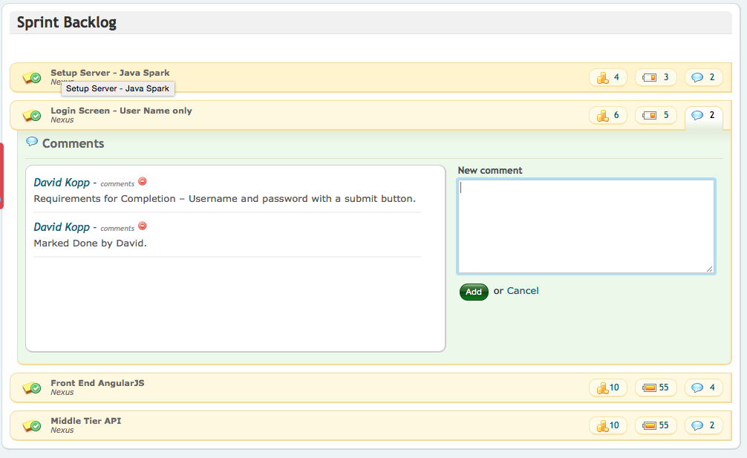
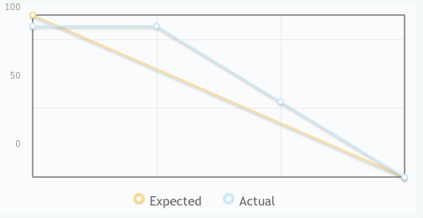
Sprint One Analysis
Notes:
(Phil) Sprint Duration: Sept. 16 – Oct. 5

Slide 9
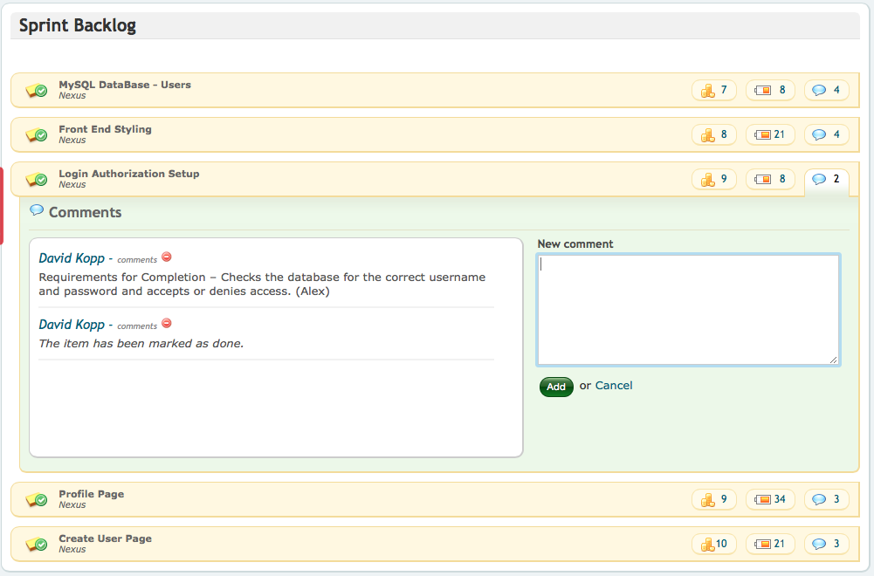
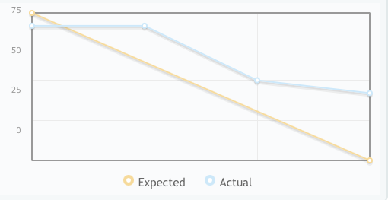
Sprint Two Analysis
Notes:
(Phil) Sprint Duration: Sept. 5 – Oct. 19

Slide 10
Product Burn Down Chart
Notes:
(Raffi) Planned over 8 sprints - 4 for each semester.

Slide 11
Communication Tools
Text Group Chat
Skype Group Chat
Google Groups
Google Drive
PangoScrum
Benefits: Well-organized, updated, and managed
Drawbacks: no bug tracking tool, (i.e. jira)
Notes:
(Raffi) Using Skype, Google Groups, and text messages.

Slide 12
Version Control
Use of Git repos
Frontend and Backend are setup as 2 separate projects
Each developer creates there own branch at the beginning of every sprint
Merge early and often
All merges completed by end of the sprint
Notes:
(Ben) Frontend – Middle Tier – has different github repos

Slide 13
Risk Analysis
Biggest Risk lies in technologies new to the team
Many features to add
Low focus on unit and end to end tests
Amount of time available for the project, may vary due to other classes
Access to data may be limited for some games
Technical Debt
Notes:
(Ben) Demo-Site via a video??

Slide 14

Questions ?

